Slide 1



01AI0506 - Design and Analysis of Algorithms
Unit – 2
Algorithm Design Techniques
Prepared by
Prof. Abhishek Chauhan
CSE- AI, ML & DS Department

Slide 2
Outline
  Sorting and searching:
  Bubble sort, Selection sort, Insertion sort, Shell sort,
  Heap sort, Binary Search, Linear search
  Divide and Conquer:
  Finding maximum and minimum, Merge sort, Quick sort
  Recurrence relation:
  Introduction, methods to solve recurrence

Slide 3
Sorting Algorithms

Slide 4
Sorting Algorithms
Sorting is any process of arranging items systematically or arranging items in a sequence ordered by some criterion.
Applications of Sorting
  Phone Bill: the calls made are date wise sorted.
  Bank statement or Credit card Bill: transactions made are date wise sorted.
  Filling forms online: “select country” drop down box will have the name of countries sorted in Alphabetical order.
  Online shopping: the items can be sorted price wise, date wise or relevance wise.
  Files or folders on your desktop are sorted date wise.

Slide 5
Sorting Algorithms
There are so many sorting algorithms used for sorting process. Some of them listed below.
        Bubble sort
        Selection sort
        Insertion sort
        Shell sort
        Heap sort

Slide 6
Bubble sort algorithm
It is a simple sorting algorithm that works by comparing each pair of adjacent items and swapping them if they are in the wrong order.
The pass through the list is repeated until no swaps are needed, which indicates that the list is sorted.
As it only uses comparisons to operate on elements, it is a comparison sort.
Although the algorithm is simple, it is too slow for practical use.

Slide 7
Bubble sort algorithm
ALGORITHM BubbleSort(A[0..n − 1])
//Sorts a given array by bubble sort
//Input: An array A[0..n − 1] of orderable elements
//Output: Array A[0..n − 1] sorted in nondecreasing order
  for i ←0 to n − 2 do
  for j ←0 to n − 2 − i do
  if A[j + 1]<A[j ]
swap A[j ] and A[j + 1]

Slide 8
Implementing Bubble Sort Algorithm
Following are the steps involved in bubble sort.
Starting with the first element(index = 0), compare the current element with the next element of the array.
If the current element is greater than the next element of the array, swap them.
If the current element is less than the next element, move to the next element. Repeat Step 1.

Slide 9
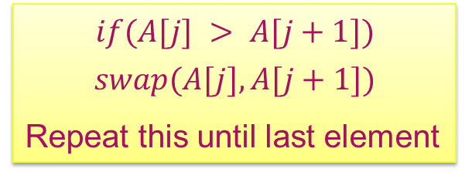
Bubble sort - Example
Sort the following array in Ascending order
45 | 34 | 56 | 23 | 12
Pass 1 :
45 34 56 23 12
swap
$$if(A[j] > A[j+1])$$
    $$swap(A[j],A[j+1])$$
    Repeat this until last element
No swap
34 45 56 23 12
34 45 56 23 12
swap
34 45 23 56 12
swap
    Now check entire array is sorted. If not repeat the same process from starting element, to last element .
34 45 23 12 56

Slide 10
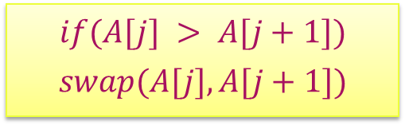
Bubble sort - Example
Pass 2 :
34 45 23 12 56
$$if(A[j] > A[j+1])$$
    $$swap(A[j],A[j+1])$$
No swap
34 45 23 12 56
swap
34 23 45 12 56
swap
34 23 12 45 56
No swap

Slide 11

Bubble sort - Example
Pass 3 :
34 23 12 45 56
$$if(A[j] > A[j+1])$$
    $$swap(A[j],A[j+1])$$
swap
23 34 12 45 56
swap
23 12 34 45 56
No swap
23 12 34 45 56
No swap

Slide 12

Bubble sort - Example
Pass 4 :
23 12 34 45 56
$$if(A[j] > A[j+1])$$
    $$swap(A[j],A[j+1])$$
swap
12 23 34 45 56
    Now check entire array is sorted. If yes, stop the process.
The sorted array….. 12 23 34 45 56

Slide 13
Selection sort algorithm
Selection sort divides the array or list into two parts,
  The sorted part at the left end
  The unsorted part at the right end
Initially, the sorted part is empty and the unsorted part is the entire list.
The smallest element is selected from the unsorted array and swapped with the leftmost element, and that element becomes a part of the sorted array.
Then it finds the second smallest element and exchanges it with the element in the second leftmost position.
This process continues until the entire array is sorted.

Slide 14
Selection sort Algorithm
ALGORITHM SelectionSort(A[0..n − 1])
//Sorts a given array by selection sort
//Input: An array A[0..n − 1] of orderable elements
//Output: Array A[0..n − 1] sorted in nondecreasing order
  for i ←0 to n − 2 do
  min←i
  for j ←i + 1 to n − 1 do
  if A[j ]<A[min]
  min←j
  swap A[i] and A[min]

Slide 15
Selection sort Algorithm
Algorithm steps
Step 1 − Set MIN to location 0
Step 2 − Search the minimum element in the list
Step 3 − Swap with value at location MIN
Step 4 − Increment MIN to point to next element
Step 5 − Repeat until the list is sorted

Slide 16
Selection sort – Example
Given Array
64 | 25 | 12 | 22 | 11
Pass: 1(n=5)
0 | 1 | 2 | 3 | 4
64 | 25 | 12 | 22 | 11
Sorted Array
Unsorted Array
0 | 1 | 2 | 3 | 4
64 | 25 | 12 | 22 | 11
64
min

Slide 17
Selection sort – Example
0 | 1 | 2 | 3 | 4
64 | 25 | 12 | 22 | 11
Sorted Array
Unsorted Array
25
min
0 | 1 | 2 | 3 | 4
64 | 25 | 12 | 22 | 11
Sorted Array
Unsorted Array
12
min

Slide 18
Selection sort – Example
0 | 1 | 2 | 3 | 4
64 | 25 | 12 | 22 | 11
Sorted Array
Unsorted Array
12
min
0 | 1 | 2 | 3 | 4
64 | 25 | 12 | 22 | 11
Sorted Array
Unsorted Array
11
min

Slide 19
Selection sort – Example
0 | 1 | 2 | 3 | 4
Sorted Array
64 | 25 | 12 | 22 | 11
swap
Unsorted Array
0 | 1 | 2 | 3 | 4
Sorted Array
11 | 25 | 12 | 22 | 64
Unsorted Array

Slide 20
Selection sort – Example
Pass: 2
0 | 1 | 2 | 3 | 4
11 | 25 | 12 | 22 | 64
Sorted Array
Unsorted Array
25
min
0 | 1 | 2 | 3 | 4
11 | 25 | 12 | 22 | 64
Sorted Array
Unsorted Array
12
min

Slide 21
Selection sort – Example
0 | 1 | 2 | 3 | 4
11 | 25 | 12 | 22 | 64
Sorted Array
Unsorted Array
12
min
0 | 1 | 2 | 3 | 4
11 | 25 | 12 | 22 | 64
Sorted Array
Unsorted Array
12
min

Slide 22
Selection sort – Example
0 | 1 | 2 | 3 | 4
11 | 25 | 12 | 22 | 64
Sorted Array
Unsorted Array
swap
0 | 1 | 2 | 3 | 4
11 | 12 | 25 | 22 | 64
Sorted Array
Unsorted Array

Slide 23
Selection sort – Example
Pass: 3
0 | 1 | 2 | 3 | 4
11 | 12 | 25 | 22 | 64
Sorted Array
Unsorted Array
25
min
0 | 1 | 2 | 3 | 4
11 | 12 | 25 | 22 | 64
Sorted Array
Unsorted Array
22
min

Slide 24
Selection sort – Example
0 | 1 | 2 | 3 | 4
11 | 12 | 25 | 22 | 64
Sorted Array
Unsorted Array
22
min
0 | 1 | 2 | 3 | 4
11 | 12 | 25 | 22 | 64
Sorted Array
Unsorted Array
swap

Slide 25
Selection sort – Example
Pass: 4
0 | 1 | 2 | 3 | 4
11 | 12 | 22 | 25 | 64
Sorted Array
Unsorted Array
0 | 1 | 2 | 3 | 4
11 | 12 | 22 | 25 | 64
Sorted Array
Unsorted Array
25
min

Slide 26
Selection sort – Example
0 | 1 | 2 | 3 | 4
11 | 12 | 22 | 25 | 64
Sorted Array
Unsorted Array
25
min
0 | 1 | 2 | 3 | 4
11 | 12 | 22 | 25 | 64
Sorted Array
Unsorted Array
0 | 1 | 2 | 3 | 4
11 | 12 | 22 | 25 | 64
Sorted Array
Video Link for Selection sort
https://drive.google.com/file/d/1yiSG5P0DQZLKwcCZDsvFTapkPl75lGEj/view?usp=drive_link

Slide 27
Insertion sort
Insertion Sort works by inserting an element into its appropriate position during each iteration.
Insertion sort works by comparing an element to all its previous elements until an appropriate position is found.
Whenever an appropriate position is found, the element is inserted there by shifting down remaining elements.

Slide 28
Insertion sort algorithm
ALGORITHM InsertionSort(A[0..n − 1])
//Sorts a given array by insertion sort
//Input: An array A[0..n − 1] of n orderable elements
//Output: Array A[0..n − 1] sorted in nondecreasing order
for i ←1 to n − 1 do
v ←A[i]
j ←i − 1
while j ≥ 0 and A[j ]> v do
A[j + 1]←A[j ]
j ←j − 1
A[j + 1]←v

Slide 29
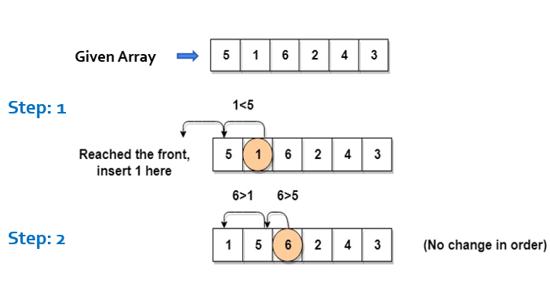
Insertion sort algorithm – Example

Slide 30
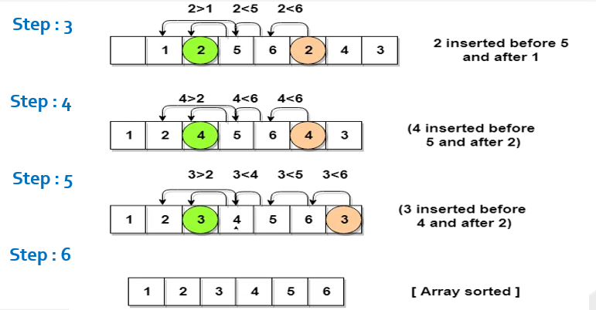
Insertion sort algorithm – Example

Slide 31
Heap sort
A heap data structure is a binary tree with the following two properties.
  It is a complete binary tree: Each level of the tree is completely filled, except possibly the bottom level. At this level it is filled from left to right.
  It satisfies the heap order property: the data item stored in each node is greater than or equal to the data item stored in its children node.
a
a
9
9
b
c
b
c
6
7
6
7
d
e
f
d
e
f
2
4
8
2
4
1
Binary Tree but not a Heap
Complete Binary Tree - Heap
Not a Heap
Heap

Slide 32
Array representation of heap
Heap can be implemented using an Array.
An array 𝐴 that represents a heap is an object with two attributes:
  𝑙𝑒𝑛𝑔𝑡ℎ[𝐴], which is the number of elements in the array, and
  ℎ𝑒𝑎𝑝−𝑠𝑖𝑧𝑒[𝐴], the number of elements in the heap stored within array 𝐴
16
Array representation of heap
14
10
16
14
10
8
7
9
3
2
4
1
8
7
9
3
2
4
1
Heap

Slide 33










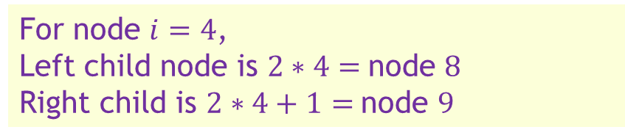
Array representation of heap
In the array 𝐴, that represents a heap
  length[𝐴] = heap-size[𝐴]
  For any node 𝒊 the parent node is 𝒊/𝟐
  For any node 𝒋, its left child is 𝟐𝒋 and right child is 𝟐𝒋+𝟏
$$1$$
16
For node $i=4$, parent node is $4/2=2$
$$2$$
$$3$$
For node $i=4$,
Left child node is $2∗4=$node $8$
Right child is $2∗4+1=$node $9$
14
10
$$4$$
$$5$$
$$6$$
$$7$$
8
7
9
3
$$1$$ | $$2$$ | $$3$$ | $$4$$ | $$5$$ | $$6$$ | $$7$$ | $$8$$ | $$9$$ | $$10$$
$$8$$
$$9$$
$$10$$
14
8
2
4
2
4
1
16
14
10
8
7
9
3
2
4
1
Heap

Slide 34
Types of heap
9
Max-Heap − Where the value of the root node is greater than or equal to either of its children.
6
7
2
4
1
1
Min-Heap − Where the value of the root node is less than or equal to either of its children.
2
4
6
7
9

Slide 35
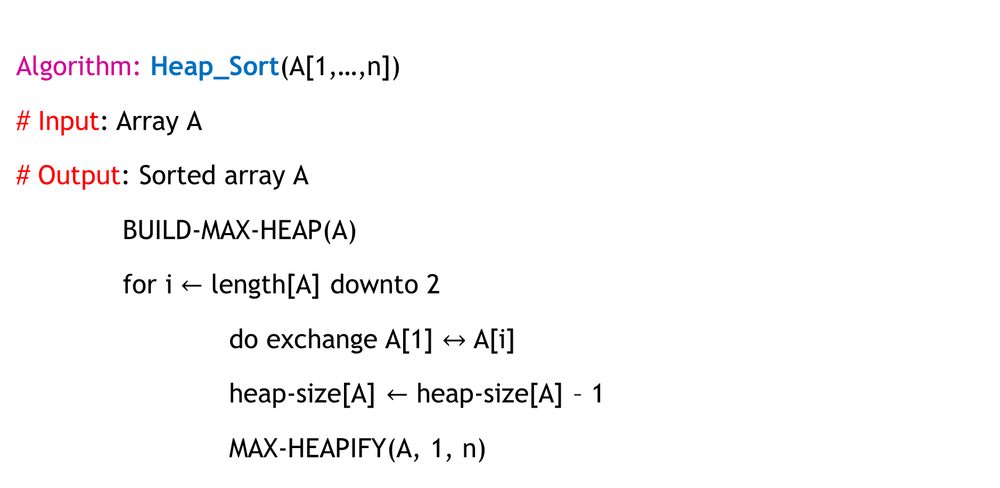
Heap sort – algorithm(Max-Heap)
Algorithm: Heap_Sort(A[1,…,n])
# Input: Array A
# Output: Sorted array A
BUILD-MAX-HEAP(A)
for i $←$ length[A] downto 2
do exchange A[1] $↔$ A[i]
heap-size[A] $←$ heap-size[A] – 1
MAX-HEAPIFY(A, 1, n)

Slide 36
Steps for build a heap sort (Max-Heap)
Build the complete binary tree using given elements.
Create Max-heap to sort in ascending order.
Once the heap is created, swap the last node with the root node and delete the last node from the heap.
Repeat step 2 and 3 until the heap is empty.

Slide 37
Heap sort – algorithm(Max-Heap)
  Algorithm: MAX-HEAPIFY(A, i)
    l ← LEFT(i)
    r ← RIGHT(i)
    if l ≤ heap-size[A] and A[l] > A[i] then
    largest ← l
    else
    largest ← I
    if r ≤ heap-size[A] and A[r] > A[largest]
    then largest ← r
    if largest ≠ I
    then exchange A[i+ ↔ A[largest]
    MAX-HEAPIFY(A, largest)

Slide 38
Heap sort – algorithm(Max-Heap)
At each step, the largest of the elements A[i], A[LEFT(i)], and A[RIGHT(i)] is determined, and its index is stored in largest.
If A[i] is largest, then the sub-tree rooted at node i is a max-heap and the procedure terminates.
Otherwise, one of the two children has the largest element, and A[i] is swapped with A[largest], which causes node i and its children to satisfy the max-heap property.
The node indexed by largest, however, now has the original value A[i], and thus the sub-tree rooted at largest may violate the max-heap property. therefore, MAX-HEAPIFY must be called recursively on that sub-tree.

Slide 39

Heap sort (Max-Heap)– Example 1
Sort the following elements in Ascending order
4 | 10 | 3 | 5 | 1
Step 1 : Create Complete Binary Tree
4
$$1$$ | $$2$$ | $$3$$ | $$4$$ | $$5$$
4 | 10 | 3 | 5 | 1
10
3
Now, a binary tree is created and we have to convert it into a Heap.
5
1

Slide 40

Heap sort – Example 1
Step 2 : Create Max Heap
$$1$$ | $$2$$ | $$3$$ | $$4$$ | $$5$$
4
10
10 is greater than 4
So, swap 10 & 4
4 | 10 | 3 | 5 | 1
10
4
10
3
4
Swap
In a Max Heap, parent node is always greater than or equal to the child nodes.
5
1

Slide 41
Heap sort – Example 1
Step 2 : Create Max Heap(Conti…)
10
5 is greater than 4
So, swap 5 & 4
$$1$$ | $$2$$ | $$3$$ | $$4$$ | $$5$$
10 | 4 | 3 | 5 | 1
5
4
4
3
5
Swap
In a Max Heap, parent node is always greater than or equal to the child nodes.
5
1
4
Max Heap is created

Slide 42
Heap sort – Example 1
Step 3 : Apply Heap Sort
10
1
$$1$$ | $$2$$ | $$3$$ | $$4$$ | $$5$$
10 | 5 | 3 | 4 | 1
1
10
5
3
Swap
Swap the first and the last nodes and
Delete the last node.
4
1
10

Slide 43
Heap sort – Example 1
Step 3 : Apply Heap Sort(Conti…)
1
5
Max Heap Property is violated so, create a Max Heap again.
$$1$$ | $$2$$ | $$3$$ | $$4$$ | $$5$$
1 | 5 | 3 | 4 | 10
5
1
1
4
5
3
1
4
Swap
4
1

Slide 44
Heap sort – Example 1
Step 3 : Apply Heap Sort (Conti…)
5
1
Max Heap is created
$$1$$ | $$2$$ | $$3$$ | $$4$$ | $$5$$
5 | 4 | 3 | 1 | 10
1
5
4
3
Swap
Swap the first and the last nodes and
Delete the last node.
1
5

Slide 45
Heap sort – example 1
Step 3 : Apply Heap Sort (Conti…)
1
Create Max Heap again
3
4
$$1$$ | $$2$$ | $$3$$ | $$4$$ | $$5$$
1 | 4 | 3 | 5 | 10
4
1
4
3
Max Heap is created
4
3
1
4
Swap
Swap the first and the last nodes and
Delete the last node.

Slide 46
Heap sort – example 1
Step 3 : Apply Heap Sort
3
Already a Max Heap
1
$$1$$ | $$2$$ | $$3$$ | $$4$$ | $$5$$
3 | 1 | 4 | 5 | 10
1
3
1
3
Swap
Swap the first and the last nodes and
Delete the last node.

Slide 47
Heap sort – Example 1
Step 3 : Apply Heap Sort
1
Already a Max Heap
$$1$$ | $$2$$ | $$3$$ | $$4$$ | $$5$$
1 | 3 | 4 | 5 | 10
1
Remove the last element from heap and the sorting is over.

Slide 48
Heap sort – Example 2
Sort given element in ascending order using heap sort. 19, 7, 16, 1, 14, 17
19 | 7 | 16 | 1 | 14 | 17
14
17
7
16
Step 1: Create binary tree
Step 2: Create Max-heap
19
19
7
16
7
16
14
17
1
14
17
1
14
17
7
16

Slide 49
Heap sort – Example 2
Step 3
Step 4
19 | 14 | 17 | 1 | 7 | 16
16 | 14 | 17 | 1 | 7 | 19
16
19
17
16
19
16
Create Max-heap
16
17
Swap & remove the last element
14
17
14
17
16
1
7
16
1
7
19

Slide 50
Heap sort – Example 2
Step 5
Step 6
17 | 14 | 16 | 1 | 7 | 19
7 | 14 | 16 | 1 | 17 | 19
7
17
16
7
17
7
Create Max-heap
7
16
Swap & remove the last element
14
16
14
16
7
1
7
1
17

Slide 51
Heap sort – Example 2
Step 7
Step 8
16 | 14 | 7 | 1 | 17 | 19
1 | 14 | 7 | 16 | 17 | 19
1
16
14
1
16
1
Create Max-heap
1
14
Swap & remove the last element
14
7
14
7
1
1
16

Slide 52
Heap sort – Example 2
Step 9
Step 10
14 | 1 | 7 | 16 | 17 | 19
7 | 1 | 14 | 16 | 17 | 19
7
14
1
7
14
7
Already a Max-heap
7
1
Swap & remove the last element
Swap & remove the last element
1
7
1
14
7
Step 11
1 | 7 | 14 | 16 | 17 | 19
1 | 7 | 14 | 16 | 17 | 19
1
Remove the last element
The entire array is sorted now.

Slide 53
Exercises
Sort the following elements using Heap Sort(Max-Heap) Method.
  34, 18, 65, 32, 51, 21
  20, 50, 30, 75, 90, 65, 25, 10, 40

Slide 54
Shell sort
Shell sort is an algorithm that first sorts the elements far apart from each other and successively reduces the interval between the elements to be sorted.
It is a generalized version of insertion sort.
Shell Sort improves its time complexity by taking the advantage of the fact that using Insertion Sort on a partially sorted array results in less number of moves.

Slide 55
Shell sort - procedure
Divide the array into several smaller non contiguous segments.
The distance between successive elements in one segment is called a gap.
Each segment is sorted within itself using insertion sort.
Then re-segment into larger segments (smaller gap) and repeat sorting process.
We will use the original sequence of shell sort, i.e., N/2, N/4,....,1 as the intervals.
We have to find the gap using formula Gap = n/2, Continue the same for each pass until only one segment is left, i.e., gap = 1.
Final sorting finishes the entire array sorting.

Slide 56
Shell sort - Example
Algorithm ShellSort(arr)
//Input: arr, an array of n elements
//Output: arr, sorted in ascending order
n ← length(arr)
gap ← floor(n / 2)
while gap > 0 do
for i ← gap to n-1 do
temp ← arr[i]
j ← i
while j ≥ gap and arr[j - gap] > temp do
arr[j] ← arr[j - gap]
j ← j - gap
end while
arr[j] ← temp
end for
gap ← floor(gap / 2)
end while

Slide 57
Shell sort - Example
0 1 2 3 4 5 6 7
9 | 8 | 3 | 7 | 5 | 6 | 4 | 1
In the first loop, if the array size is N = 8 then, the elements lying at the interval of N/2 = 4 are compared and swapped if they are not in order.
The 0th element is compared with the 4th element.
If the 0th element is greater than the 4th one then, the 4th element is first stored in temp variable and the 0th element (ie. greater element) is stored in the 4th position and the element stored in temp is stored in the 0th position.

Slide 58
Shell sort - Example
How swapping happening here?
0 1 2 3 4 5 6 7
9 | 8 | 3 | 7 | 5 | 6 | 4 | 1
9 | 8 | 3 | 7 | 5 | 6 | 4 | 1
9 | 8 | 3 | 7 | 9 | 6 | 4 | 1
5
5 | 8 | 3 | 7 | 9 | 6 | 4 | 1

Slide 59
Shell sort - Example
0 | 1 | 2 | 3 | 4 | 5 | 6 | 7
9 | 8 | 3 | 7 | 5 | 6 | 4 | 1
Here n = n/2
= 8/2 = 4
So gap is now 4
9 | 8 | 3 | 7 | 5 | 6 | 4 | 1
5 | 8 | 3 | 7 | 9 | 6 | 4 | 1
Pass 1
5 | 6 | 3 | 7 | 9 | 8 | 4 | 1
5 | 6 | 3 | 7 | 9 | 8 | 4 | 1
5 | 6 | 3 | 1 | 9 | 8 | 4 | 7

Slide 60
Shell sort - Example
0 | 1 | 2 | 3 | 4 | 5 | 6 | 7
5 | 6 | 3 | 1 | 9 | 8 | 4 | 7
Here = 8/4 = 2
So gap is now 2
5 | 6 | 3 | 1 | 9 | 8 | 4 | 7
3 | 6 | 5 | 1 | 9 | 8 | 4 | 7
3 | 1 | 5 | 6 | 9 | 8 | 4 | 7
Pass 2
3 | 1 | 5 | 6 | 9 | 8 | 4 | 7
3 | 1 | 5 | 6 | 9 | 8 | 4 | 7
3 | 1 | 5 | 6 | 9 | 8 | 4 | 7

Slide 61
Shell sort - Example
3 | 1 | 5 | 6 | 9 | 8 | 4 | 7
3 | 1 | 5 | 6 | 4 | 8 | 9 | 7
3 | 1 | 4 | 6 | 5 | 8 | 9 | 7
Pass 2 (continues)
3 | 1 | 4 | 6 | 5 | 7 | 9 | 8
3 | 1 | 4 | 6 | 5 | 7 | 9 | 8

Slide 62
Shell sort - Example
0 | 1 | 2 | 3 | 4 | 5 | 6 | 7
3 | 1 | 4 | 6 | 5 | 7 | 9 | 8
Here = 8/8 = 1
So gap is now 1
3 | 1 | 4 | 6 | 5 | 7 | 9 | 8
1 | 3 | 4 | 6 | 5 | 7 | 9 | 8
1 | 3 | 4 | 6 | 5 | 7 | 9 | 8
Pass 3
1 | 3 | 4 | 6 | 5 | 7 | 9 | 8
1 | 3 | 4 | 5 | 6 | 7 | 9 | 8
1 | 3 | 4 | 5 | 6 | 7 | 9 | 8
1 | 3 | 4 | 5 | 6 | 7 | 9 | 8

Slide 63
Shell sort - Example
1 | 3 | 4 | 5 | 6 | 7 | 9 | 8
1 | 3 | 4 | 5 | 6 | 7 | 8 | 9
1 | 3 | 4 | 5 | 6 | 7 | 8 | 9
Pass 3(Continues ..)

Slide 64


Shell sort Analysis
Time Complexity
The time complexity of Shell sort is heavily dependent on the choice of the gap sequence.
Best Case: When the array is already sorted, the best-case time complexity is
Average Case: The average-case time complexity varies with the gap sequence, but it is generally considered to be or better with optimal sequences.
Worst Case: The worst-case time complexity is , but this is rarely encountered with a good gap sequence.

Slide 65
Binary Search

Slide 66
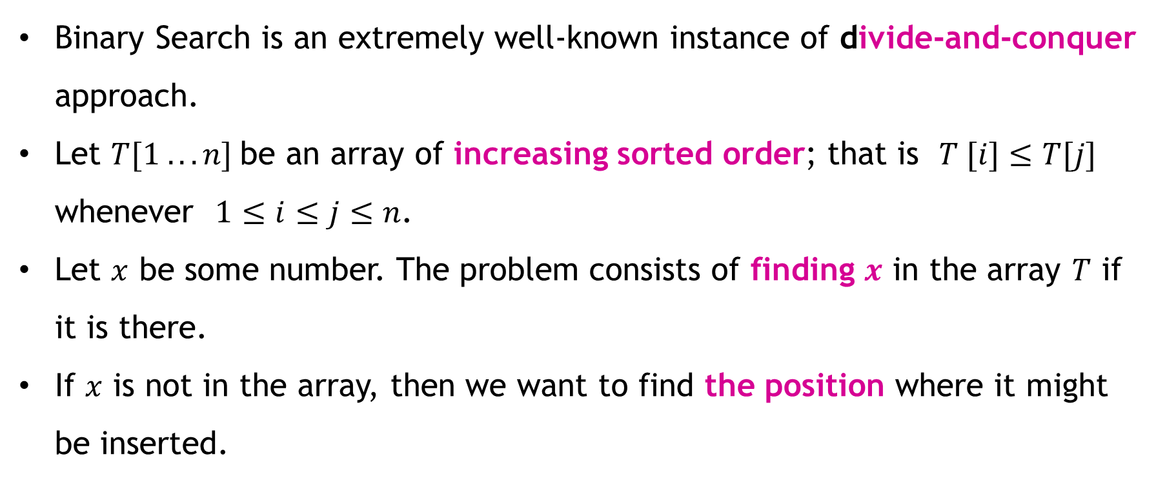
Binary Search - Introduction
Binary Search is an extremely well-known instance of divide-and-conquer approach.
Let $T[1 . . . n]$be an array of increasing sorted order; that is $T [i]≤T[j]$ whenever $1≤i≤j≤n$.
Let $x$ be some number. The problem consists of finding $x$ in the array $T$ if it is there.
If $x$ is not in the array, then we want to find the position where it might be inserted.

Slide 67
Binary Search - Introduction
Compare the middle element of the search space with the key.
If the key is found at middle element, the process is terminated.
If the key is not found at middle element, choose which half will be used as the next search space.
  If the key is smaller than the middle element, then the left side is used for next search.
  If the key is larger than the middle element, then the right side is used for next search.
This process is continued until the key is found or the total search space is exhausted.

Slide 68
Binary Search – Example 1
0 | 1 | 2 | 3 | 4 | 5 | 6 | 7 | 8 | 9
Step: 1
5 | 9 | 17 | 23 | 25 | 45 | 59 | 63 | 71 | 89
low
high
Low | High | mid
0 | 9 | 4
Key = 59
mid = low + high / 2
0 | 1 | 2 | 3 | 4 | 5 | 6 | 7 | 8 | 9
Step: 2
5 | 9 | 17 | 23 | 25 | 45 | 59 | 63 | 71 | 89
low
mid
high
Key = 59 a[mid]= a[4]= 25

Slide 69
Step : 3
Binary Search – Example 1
0 | 1 | 2 | 3 | 4 | 5 | 6 | 7 | 8 | 9
5 | 9 | 17 | 23 | 25 | 45 | 59 | 63 | 71 | 89
low
high
Key = 59
Low | High | mid
0 | 9 | 4
5 | 9 | 7
0 | 1 | 2 | 3 | 4 | 5 | 6 | 7 | 8 | 9
Step : 4
5 | 9 | 17 | 23 | 25 | 45 | 59 | 63 | 71 | 89
low
mid
high
Key = 59 a[mid]= a[7]= 63

Slide 70
Binary Search - Example 1
0 | 1 | 2 | 3 | 4 | 5 | 6 | 7 | 8 | 9
Step : 5
5 | 9 | 17 | 23 | 25 | 45 | 59 | 63 | 71 | 89
low
high
Key = 59
Low | High | mid
0 | 9 | 4
5 | 9 | 7
5 | 6 | 5
0 | 1 | 2 | 3 | 4 | 5 | 6 | 7 | 8 | 9
Step : 6
5 | 9 | 17 | 23 | 25 | 45 | 59 | 63 | 71 | 89
low
high
mid
Key = 59 a[mid]= a[5]= 45

Slide 71
Binary Search – Example 1
0 | 1 | 2 | 3 | 4 | 5 | 6 | 7 | 8 | 9
Step : 7
5 | 9 | 17 | 23 | 25 | 45 | 59 | 63 | 71 | 89
low
high
Key= 59
Low | High | mid
0 | 9 | 4
5 | 9 | 7
5 | 6 | 5
6 | 6 | 6
0 | 1 | 2 | 3 | 4 | 5 | 6 | 7 | 8 | 9
Step : 8
5 | 9 | 17 | 23 | 25 | 45 | 59 | 63 | 71 | 89
high
mid
low
Key = 59 a[mid]= a[6]= 59

Slide 72
Binary Search - Example 2(if data is not found)
0 | 1 | 2 | 3 | 4 | 5 | 6 | 7 | 8 | 9
Step : 1
5 | 9 | 17 | 23 | 25 | 45 | 59 | 63 | 71 | 89
low
high
Low | High | mid
0 | 9 | 4
Key = 60
0 | 1 | 2 | 3 | 4 | 5 | 6 | 7 | 8 | 9
Step : 2
5 | 9 | 17 | 23 | 25 | 45 | 59 | 63 | 71 | 89
low
mid
high
Key= 60 a[mid]= a[4]= 25

Slide 73
Binary Search Example 2-(if data is not found)
0 | 1 | 2 | 3 | 4 | 5 | 6 | 7 | 8 | 9
Step : 3
5 | 9 | 17 | 23 | 25 | 45 | 59 | 63 | 71 | 89
low
high
Key = 60
Low | High | mid
0 | 9 | 4
5 | 9 | 7
Step : 4
0 | 1 | 2 | 3 | 4 | 5 | 6 | 7 | 8 | 9
5 | 9 | 17 | 23 | 25 | 45 | 59 | 63 | 71 | 89
low
mid
high
Key = 60 a[mid]= a[7]= 63

Slide 74
Binary Search - Example 2 (if data is not found)
0 | 1 | 2 | 3 | 4 | 5 | 6 | 7 | 8 | 9
Step : 5
5 | 9 | 17 | 23 | 25 | 45 | 59 | 63 | 71 | 89
low
high
Key = 60
Low | High | mid
0 | 9 | 4
5 | 9 | 7
5 | 6 | 5
0 | 1 | 2 | 3 | 4 | 5 | 6 | 7 | 8 | 9
Step : 6
5 | 9 | 17 | 23 | 25 | 45 | 59 | 63 | 71 | 89
low
high
Key = 60 a[mid]= a[5]= 45
mid

Slide 75
Binary Search - Example 2 (if data is not found)
0 | 1 | 2 | 3 | 4 | 5 | 6 | 7 | 8 | 9
Step : 7
5 | 9 | 17 | 23 | 25 | 45 | 59 | 63 | 71 | 89
high
low
Low | High | mid
0 | 9 | 4
5 | 9 | 7
5 | 6 | 5
6 | 6 | 6
Key = 60
0 | 1 | 2 | 3 | 4 | 5 | 6 | 7 | 8 | 9
Step : 8
5 | 9 | 17 | 23 | 25 | 45 | 59 | 63 | 71 | 89
high
mid
Key = 60 a[mid]= a[6]= 59
low

Slide 76
Binary Search - Example 2(if data is not found)
0 | 1 | 2 | 3 | 4 | 5 | 6 | 7 | 8 | 9
Step : 9
5 | 9 | 17 | 23 | 25 | 45 | 59 | 63 | 71 | 89
high
low
Key = 60
Low | High | mid
0 | 9 | 4
5 | 9 | 7
5 | 6 | 5
6 | 6 | 6
7 | 6 | 6
If (low> high) we should stop. And return -1. element is not found.

Slide 77
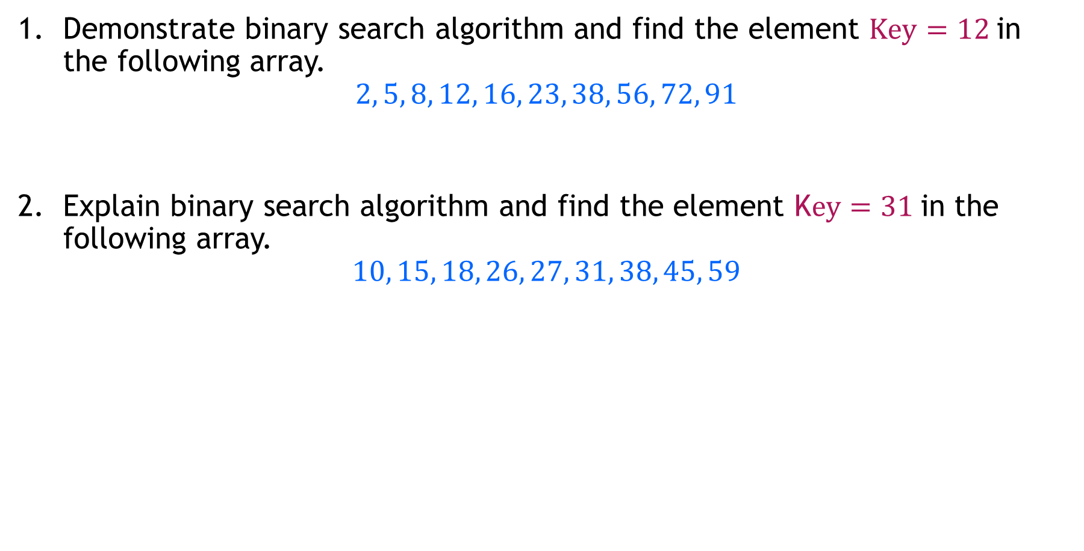
Binary Search – Examples
Demonstrate binary search algorithm and find the element $Key=12$in the following array.
$$2, 5, 8, 12, 16, 23, 38, 56, 72, 91$$
Explain binary search algorithm and find the element K$ey=31$in the following array.
$$10, 15, 18, 26, 27, 31, 38, 45, 59$$

Slide 78
Divide and Conquer

Slide 79
Divide and Conquer – Introduction
Divide and conquer algorithm operates in three stages:
  Divide: Divide the problem recursively into smaller subproblems.
  Solve: Subproblems are solved independently.
  Combine: Combine subproblem solutions in order to deduce the answer to the original large problem.
Because subproblems are identical to the main problem but have smaller parameters, they can be readily solved using recursion.
When a subproblem is reduced to its lowest feasible size, it is solved, and the results are recursively integrated to produce a solution to the original larger problem.

Slide 80
Divide and Conquer – Introduction
Divide and conquer is a top-down, multi-branched recursive method.
Each branch represents a subproblem and calls itself with a smaller argument.
Understanding and developing divide and conquer algorithms requires expertise and sound reasoning.
The divide and conquer approach is depicted graphically in following figure.
Subproblems may not be exactly n/2 in size.

Slide 81
Divide and Conquer – Introduction

Slide 82
Divide and Conquer – Introduction
Applications of Divide and Conquer Approach
Many computer science problems are effectively solved using divide and conquer. Few of them are listed here:
Finding an exponential number
Multiplying large integers
Multiplying matrices (Strassen’s algorithm)
Sorting data
Quicksort
Merge sort
Binary search
Discrete Fourier Transform
Closest pair problem
Max-min problem

Slide 83
Min - Max Problem
Max-Min problem is to find a maximum and minimum element from the given array. We can effectively solve it using divide and conquer approach.
In the traditional approach, the maximum and minimum element can be found by comparing each element and updating Max and Min values as and when required.
This approach is simple but it does (n – 1) comparisons for finding max and the same number of comparisons for finding the min.
It results in a total of 2(n – 1) comparisons. Using a divide and conquer approach, we can reduce the number of comparisons.

Slide 84
Min- Max Problem
Divide and conquer approach for Max. Min problem works in three stages.
If a1 is the only element in the array, a1 is the maximum and minimum.
If the array contains only two elements a1 and a2, then the single comparison between two elements can decide the minimum and maximum of them.
If there are more than two elements, the algorithm divides the array from the middle and creates two sub problems. Both sub problems are treated as an independent problem and the same recursive process is applied to them. This division continues until sub problem size becomes one or two.

Slide 85
Min- Max Problem
After solving two sub-problems, their minimum and maximum numbers are compared to build the solution of the large problem.
This process continues in a bottom-up fashion to build the solution of a parent problem.

Slide 86
Algorithm for Max-Min Problem
Algorithm DC_MAXMIN (A, low, high)
// Description : Find minimum and maximum element from array using divide and conquer approach
// Input : Array A of length n, and indices low = 0 and high = n - 1
// Output : (min, max) variables holding minimum and maximum element of array
if n == 1 then
return (A[1], A[1])
else if n == 2 then
if A[1] < A[2] then
return (A[1], A[2])
else
return (A[2], A[1])
else
mid ← (low + high) / 2
[LMin, LMax] = DC_MAXMIN (A, low, mid)
[RMin, RMax] = DC_MAXMIN (A, mid + 1, high)
if LMax > RMax then // Combine solution
max ← LMax
else
max ← RMax
end
if LMin < RMin then // Combine solution
min ← LMin
else
min ← RMin
end
return (min, max)
end

Slide 87
Min- Max Problem - Example
Problem: Find max and min from the sequence 33, 11, 44, 55, 66, 22 using divide and conquer approach
Solution:
During the divide step, the algorithm divides the array until it reaches a size of one or two.
Once the array size reaches the base case, we may get the maximum and minimum number from each array recursively.
This method is continued until all of the subarrays have been processed.

Slide 88
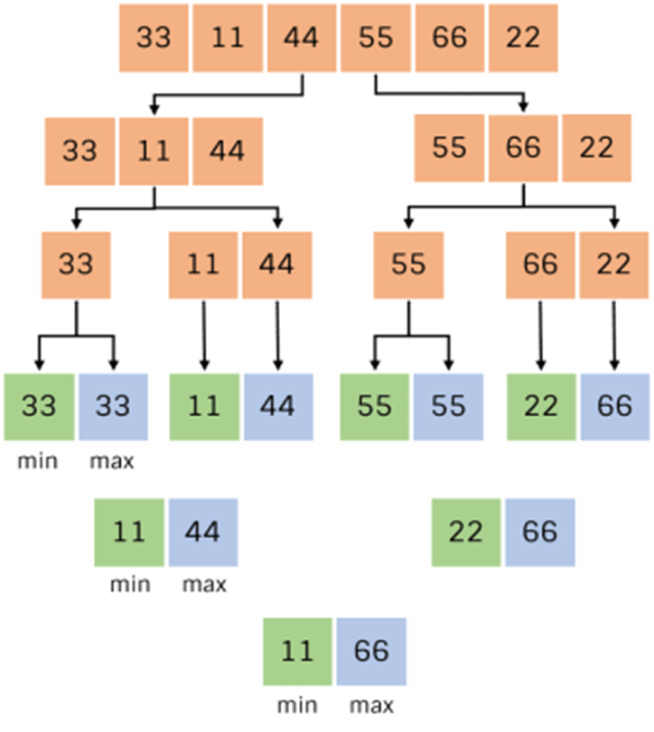
Min- Max Problem - Example
Steps to find min and max value from array.
Step 1: List the array in the given sequence.
Step 2: Divided into sub array in two and check the array reaches a size of one or two.
Step 3: If not, divides the array until it reaches a size of one or two.
Step 4: Now set min & max value of each sub array then compare with subarray values. Here 33 is considered min and max.
Step 5: Now we got compared and stored min and max values then repeat the same.
Step 6: Finally we got min and max value from the array.

Slide 89
Merge sort Algorithm – Introduction
Merge sort sorts the list using divide and conquers strategy. Unlike selection sort, bubble sort or insertion sort, it sorts data by dividing the list into sub lists and recursively solving and combining them.
It works on following two basic principles :
Sorting a smaller list takes less time than sorting a larger list.
Combining two sorted sublists takes less time than combining two unsorted lists.

Slide 90
Merge sort Algorithm
Merge sort works in three stages :
Divide : Recursively divide the single list into two sublists until each sublist contains 1 element.
Conquer : Sort both sublists of parent list. List of 1 element is sorted.
Combine : Recursively combine sorted sublists until the list of size n is produced.

Slide 91
Merge Sort Algorithm
ALGORITHM Mergesort(A[0..n − 1])
//Sorts array A[0..n − 1] by recursive mergesort
//Input: An array A[0..n − 1] of orderable elements
//Output: Array A[0..n − 1] sorted in nondecreasing order
if n > 1
copy A[0..n/2 − 1] to B[0..n/2 − 1]
copy A[n/2..n − 1] to C[0..n/2 − 1]
Mergesort(B[0..n/2 − 1])
Mergesort(C[0..n/2 − 1])
Merge(B, C, A) //see below

Slide 92
Merge Sort Algorithm
ALGORITHM Merge(B[0..p − 1], C[0..q − 1], A[0..p + q − 1])
//Merges two sorted arrays into one sorted array
//Input: Arrays B[0..p − 1] and C[0..q − 1] both sorted
//Output: Sorted array A[0..p + q − 1] of the elements of B and C
i ←0; j ←0; k←0
while i <p and j <q do
if B[i]≤ C[j ]
A[k]←B[i]; i ←i + 1
else A[k]←C[j ]; j ←j + 1
k←k + 1
if i = p
copy C[j..q − 1] to A[k..p + q − 1]
else copy B[i..p − 1] to A[k..p + q − 1]

Slide 93
Merge sort Algorithm
Algorithm Procedure
Divide the unsorted list into N sub lists, each containing 1 element
Take adjacent pairs of two singleton lists and merge them to form a list of 2 elements. N will now convert into N/2 lists of size 2
Repeat the process till a single sorted list of all the elements is obtained

Slide 94
Merge Sort – Example
Unsorted Array
724 | 521 | 2 | 98 | 529 | 31 | 189 | 451
1 | 2 | 3 | 4 | 5 | 6 | 7 | 8
Step 1: Split the selected array
1
2
3
4
5
6
7
8
724
521
2
98
529
31
189
451
724
521
2
98
529
31
189
451
1
2
3
4
1
2
3
4

Slide 95
Merge Sort – Example
Select the left subarray and Split
Select the right subarray and Split
1
2
3
4
1
2
3
4
724
521
2
98
529
31
189
451
1
2
1
2
Split
1
2
1
2
724
521
2
98
529
31
189
451
1
1
1
1
1
1
1
1
724
521
2
98
529
31
189
451
521
724
2
98
31
529
189
451
Merge
2
98
521
724
31
189
451
529
2
31
98
189
451
521
529
724

Slide 96

Quick Sort Algorithm – Introduction
Quicksort is the other important sorting algorithm that is based on the divide-and conquer approach.
Unlike merge sort, which divides its input elements according to their position in the array, quicksort divides them according to their value.
A partition is an arrangement of the array’s elements so that all the elements to the left of some element A[s] are less than or equal to A[s], and all the elements to the right of A[s] are greater than or equal to it.

Slide 97
Quick Sort Algorithm – Introduction
After a partition is achieved, A[s] will be in its final position in the sorted array, and we can continue sorting the two subarrays to the left and to the right of A[s] independently.
After we have to call Quicksort(A[0..n − 1]) algorithm. Before that we have to choose the pivot element.
Pivot: An element with respect to whose value we are going to divide the subarray.
In the Quick Sort algorithm, the pivot element is a crucial part of the partitioning process, where the array is divided into two subarrays:
    one array containing elements smaller than the pivot
    Another containing elements greater than the pivot

Slide 98
Quick Sort Algorithm – Introduction
Selecting Pivot :
There are several strategies for choosing a pivot element in an array for Quick Sort.
      Choose the first element as the pivot
      Choose the last element as the pivot
      Choose the middle element as the pivot
      Randomly select a pivot
      Median-of-three pivot
      Randomized pivot
      As per Hoare(Author of quick sort) algorithm, we are Choosing the first element as the pivot.

Slide 99
Quick Sort – Pseudo code
ALGORITHM Quicksort(A[l..r])
//Sorts a subarray by quicksort
//Input: Subarray of array A[0..n − 1], defined by its left(l) and right(r)
//Output: Subarray A[l..r] sorted in non-decreasing order
if l < r
  s ←Partition(A[l..r]) //s is a split position
  Quicksort(A[l..s − 1])
  Quicksort(A[s + 1..r])

Slide 100
Quick Sort Algorithm
After selecting pivot, scan the subarray from both ends, comparing the subarray’s elements to the pivot.
The left-to-right scan, denoted below by index pointer i, starts with the second element.
  If Element is smaller than the pivot to be in the left part of the subarray, this scan skips over elements that are smaller than the pivot.
  Then Stops upon encountering the first element greater than or equal to the pivot.

Slide 101
Quick Sort Algorithm
The right-to-left scan, denoted below by index pointer j, starts with the last element of the subarray.
  If the element is larger than the pivot to be in the right part of the subarray, this scan skips over elements that are larger than the pivot.
  Then stops on encountering the first element smaller than or equal to the pivot.

Slide 102
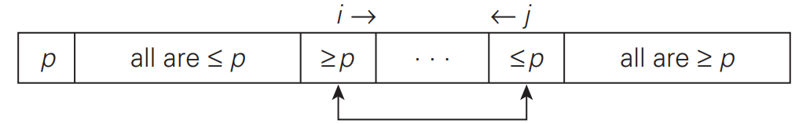
Quick Sort Algorithm
After both scans stop, three situations may arise, depending on whether or not the scanning indices have crossed.
Case 1:
If scanning indices i and j have not crossed, i.e., i < j, we simply exchange A[i] and A[j ] and resume the scans by incrementing i and decrementing j, respectively.

Slide 103
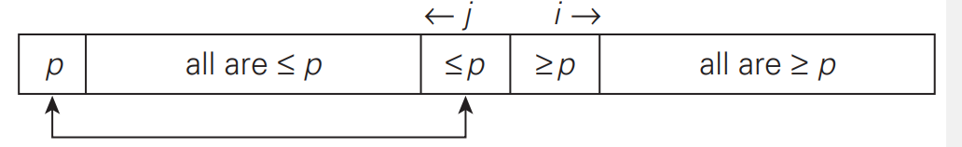
Quick Sort Algorithm
Case 2:
If the scanning indices have crossed over, i.e., i > j, we will have partitioned the subarray after exchanging the pivot with A[j ]

Slide 104
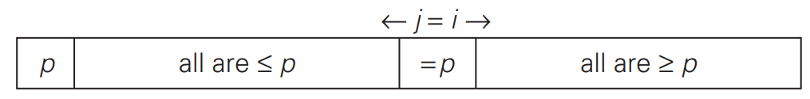
Quick Sort Algorithm
Case 3:
Finally, if the scanning indices stop while pointing to the same element, i.e., i = j, the value they are pointing to must be equal to p. Thus, we have the subarray partitioned, with the split position s = i = j :
We can combine the last case with the case of crossed-over indices (i > j ) by exchanging the pivot with A[j ] whenever i ≥ j .

Slide 105
Quick Sort Algorithm
ALGORITHM Partition(A[l..r])
//Partitions a subarray by Hoare’s algorithm, using the first element as a pivot
//Input: Subarray of array A[0..n − 1], defined by its left(l) and right(r) and (l < r)
//Output: Partition of A[l..r], with the split position returned as this function’s value
  p ← A[l]
  i ← l; j ← r + 1
  repeat
  repeat i ← i + 1 until A[i] ≥ p
  repeat j ← j − 1 until A[j ] ≤ p
  swap(A[i], A[j ])
  until i ≥ j
  swap(A[i], A[j ]) //undo last swap when i ≥ j
  swap(A[l], A[j ])
  return j

Slide 106


Quick Sort Algorithm – Example
Consider the following unsorted list of the elements.
Index 0 1 2 3 4 5 6 7
Step 1: Set the pivot and left and right position.
0 1 2 3 4 5 6 7
//Here we set first element as pivot,
// left and right position denoted as i and j.
Pivot i j
Compare i with pivot if i is equal or less than to pivot then increase i + 1.

Slide 107
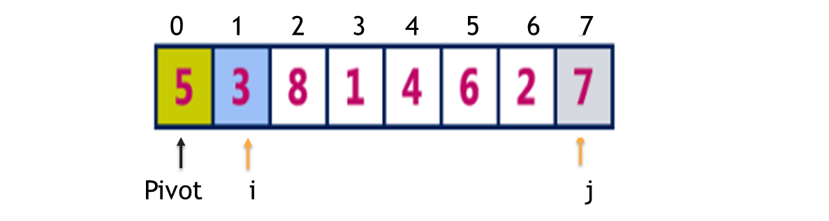
Quick Sort Algorithm – Example
Step 2: Follow the given steps below
Compare i^{th} element with pivot element,
If A[i] is greater than pivot then stop i otherwise move i to the next.
Compare A[j] with pivot,
If A[j] is smaller than pivot then stop right otherwise move right to the previous.
Repeat the same until i>=j.
If both i & j are stopped but i<j then swap “i” with “j” and continue the process.
If i>=j then swap pivot with j.

Slide 108
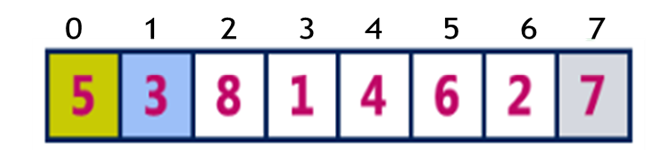
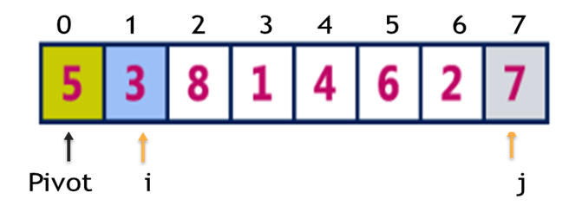
Quick Sort Algorithm – Example
Step 3:
as
Compare i < pivot as it is true, increment i by one and repeat the same, i will stop at 8.
Compare j>pivot as it is true, decrement right by one and repeat the same, right will stop at 2.

Slide 109

Quick Sort Algorithm – Example
Step 4:
//Here i & j both are stopped and i is not greater than j, so we need to swap A[i] and A[j]
as
Step 5:
// Here 2 and 8 was swapped
as

Slide 110
Quick Sort Algorithm – Example
Step 6:
Now we Compare j<pivot as it is true, increment j by one and repeat the same, j will stop at 6.
Compare i >pivot as it is true, decrement i by one and repeat the same, j will stop at 4.
as

Slide 111


Quick Sort Algorithm – Example
Step 7:
Here we can observe that all the numbers to the left(i) side of 5 are smaller and right(j) side are greater. That means 5 is placed in its correct position. Repeat the same process on the left sub list and right sub list to the number 5.
as
as
In the left sub list as there are no smaller number than the pivot left will keep on moving to the next and stops at last number. As the right(j) is smaller, right(j) stops at same position. Now left(i) and right(j) both are equal. so we swap pivot with right(j).
Step 8:
as

Slide 112

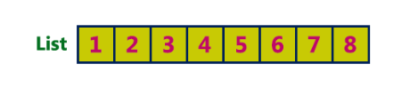
Quick Sort Algorithm – Example
Step 9:
In the right sub list left is greater than the pivot, left will stop at same position. As the List[right] is greater than List[pivot], right moves towards left and stops at pivot number position. Now left > right so we swap pivot with right. (6 is swap by itself).
Step 10:
Repeat the same recursively on both left and right sub lists until all the numbers are sorted. The final sorted list will be as follows.

Slide 113
Quick Sort Algorithm
Complexity of the Quick Sort Algorithm
To sort an unsorted list with 'n' number of elements, we need to make ((n-1)+(n-2)+(n-3)+......+1) = (n (n-1))/2 number of comparisons in the worst case. If the list is already sorted, then it requires 'n' number of comparisons.
    Worst Case : O(n2)
    Best Case : O (n log n)
    Average Case : O (n log n)

Slide 114
Introduction - Recurrence relation
Many algorithms (divide and conquer) are recursive in nature.
When we analyze them, we get a recurrence relation for time complexity.
We get running time as a function of 𝒏 (input size) and we get the running time on inputs of smaller sizes.

Slide 115
Recurrence equation
Recurrence :
A recurrence is a recursive description of a function, or a description of a function in terms of itself.
Recurrence relation:
A recurrence relation recursively defines a sequence where the next term is a function of the previous terms.
Equation that defines a sequence recursively.
  T(n) = T(n-1) + n, n>0 -------(1 (recurrence relation))
  T(0) = 0 -------(2 (initial condition))

Slide 116
Methods to solve the Recurrence equation
Recurrence equation
Substitution method
Forward substitution
Backward substitution
Master’s method
Recurrence tree method

Slide 117
Substitution Method
The substitution method comprises of 3 steps
  Guess the form of the solution
  Verify by induction
  Solve for constants
We substitute the guessed solution for the function when applying the inductive hypothesis to smaller values.
Hence the name “substitution method”. This method is powerful, but we must be able to guess the form of the answer in order to apply it.

Slide 118





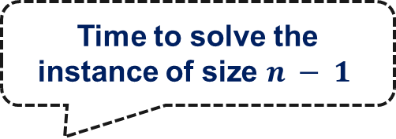
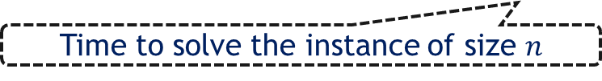
Substitution Method – Example
We make a guess for the solution and then we use mathematical induction to prove the guess is correct or incorrect.
Replacing $n$ by $n−1$ and $n−2$, we can write following equations.
Substituting equation $3$ in $2$ and equation $2$ in $1$ we have now,
Time to solve the instance of size $n − 1$
Example :
$$T(n)=T(n−1)+n$$
1
Time to solve the instance of size $n$
$$T\left(n−1\right)=T\left(n−2\right)+n−1$$
2
$$T\left(n−2\right)=T\left(n−3\right)+n−2$$
3
$$T(n)=T(n−3)+n−2+n−1+n$$
4

Slide 119

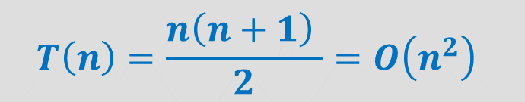


Substitution Method – Example
From above, we can write the general form as,
Suppose, if we take $k = n$then,
$$T(n)=T(n−3)+n−2+n−1+n$$
4
$$T\left(n\right)=T\left(n−k\right)+(n−k+1)+(n−k+2)+ …+n$$
$$T\left(n\right)=T\left(n−n\right)+(n−n+1)+(n−n+2)+ …+n$$
$$T\left(n\right)=0+1+2+ …+n$$
$$T\left(n\right)=\frac{n\left(n+1\right) }{2}=O\left(n^{2}\right)$$

Slide 120
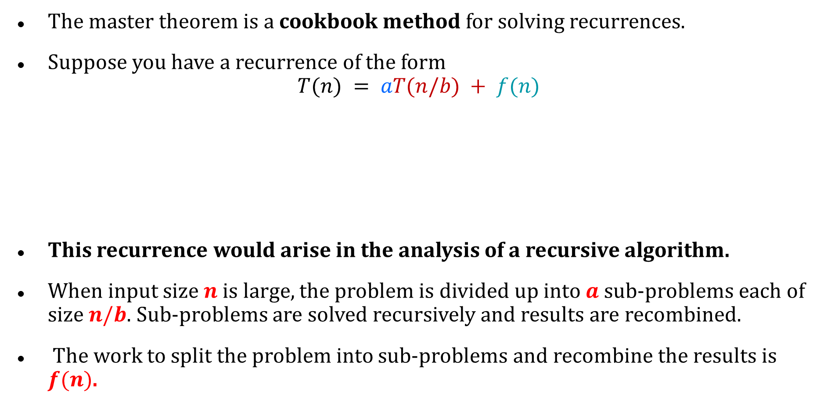
Master Theorem
The master theorem is a cookbook method for solving recurrences.
Suppose you have a recurrence of the form
$$T(n) = aT(n/b) + f(n)$$
This recurrence would arise in the analysis of a recursive algorithm.
When input size $n$ is large, the problem is divided up into $a$ sub-problems each of size $n/b$. Sub-problems are solved recursively and results are recombined.
The work to split the problem into sub-problems and recombine the results is $f(n)$.
Time to divide & recombine
Number of sub-problems
Time required to solve a sub-problem

Slide 121
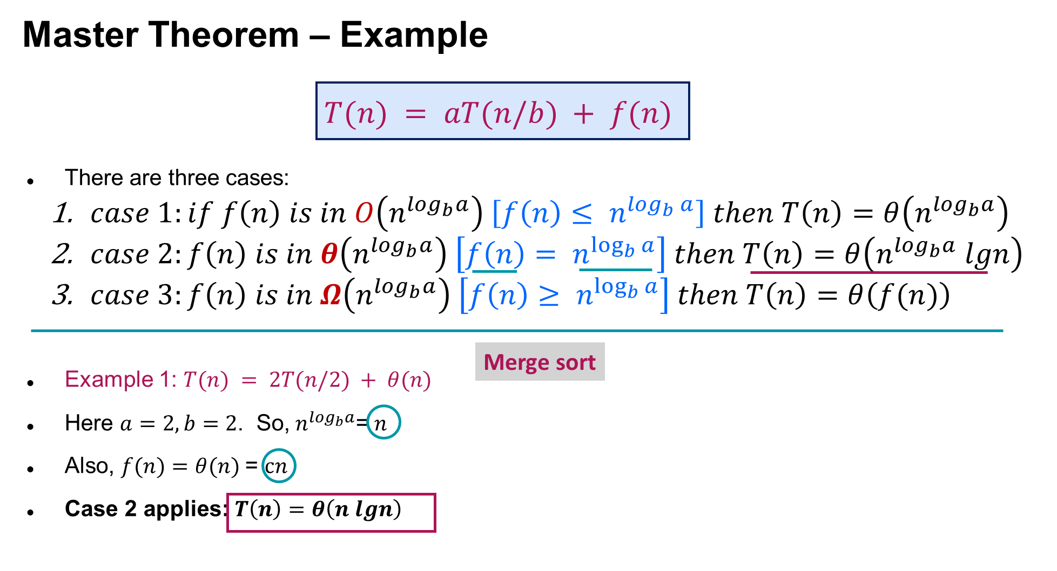

Slide 122
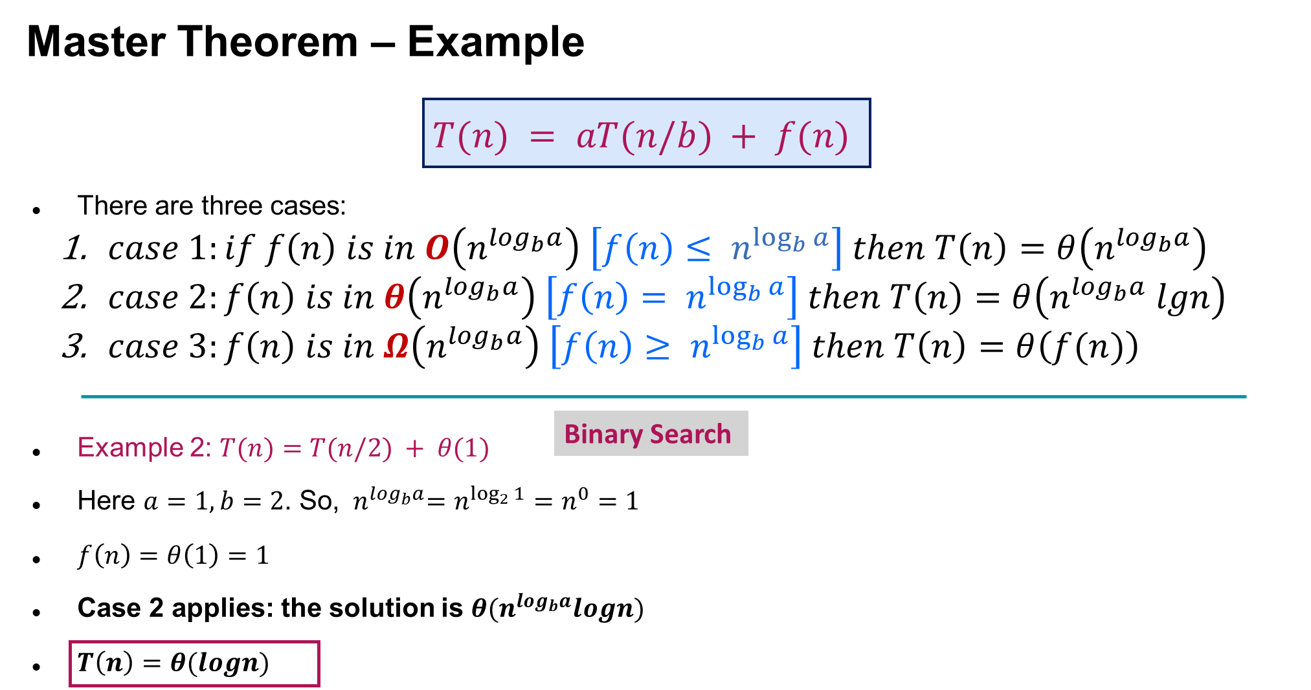

Slide 123
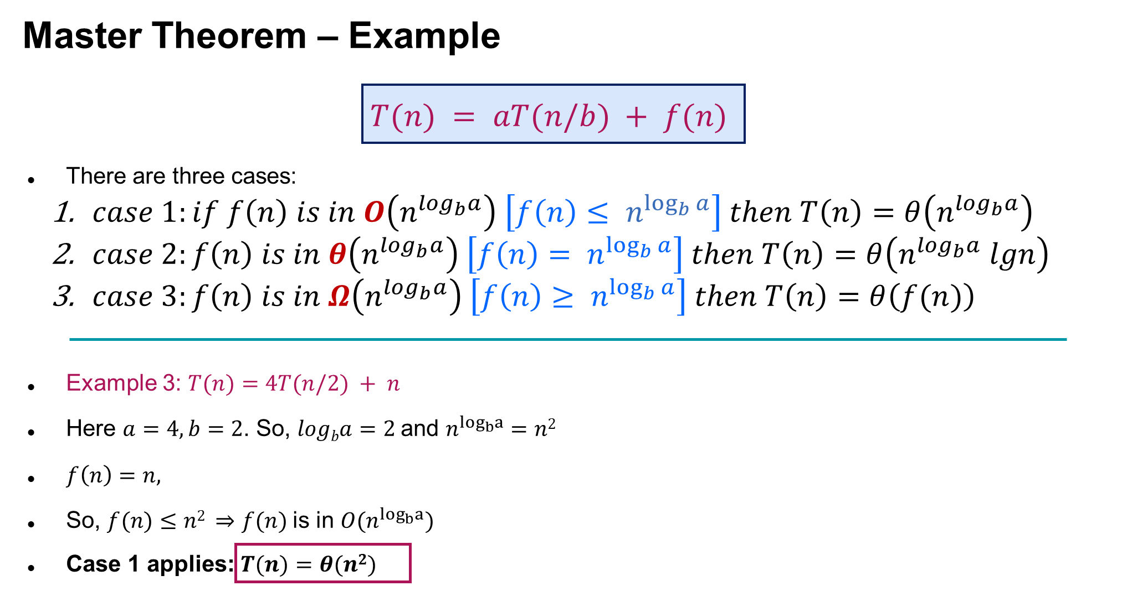

Slide 124

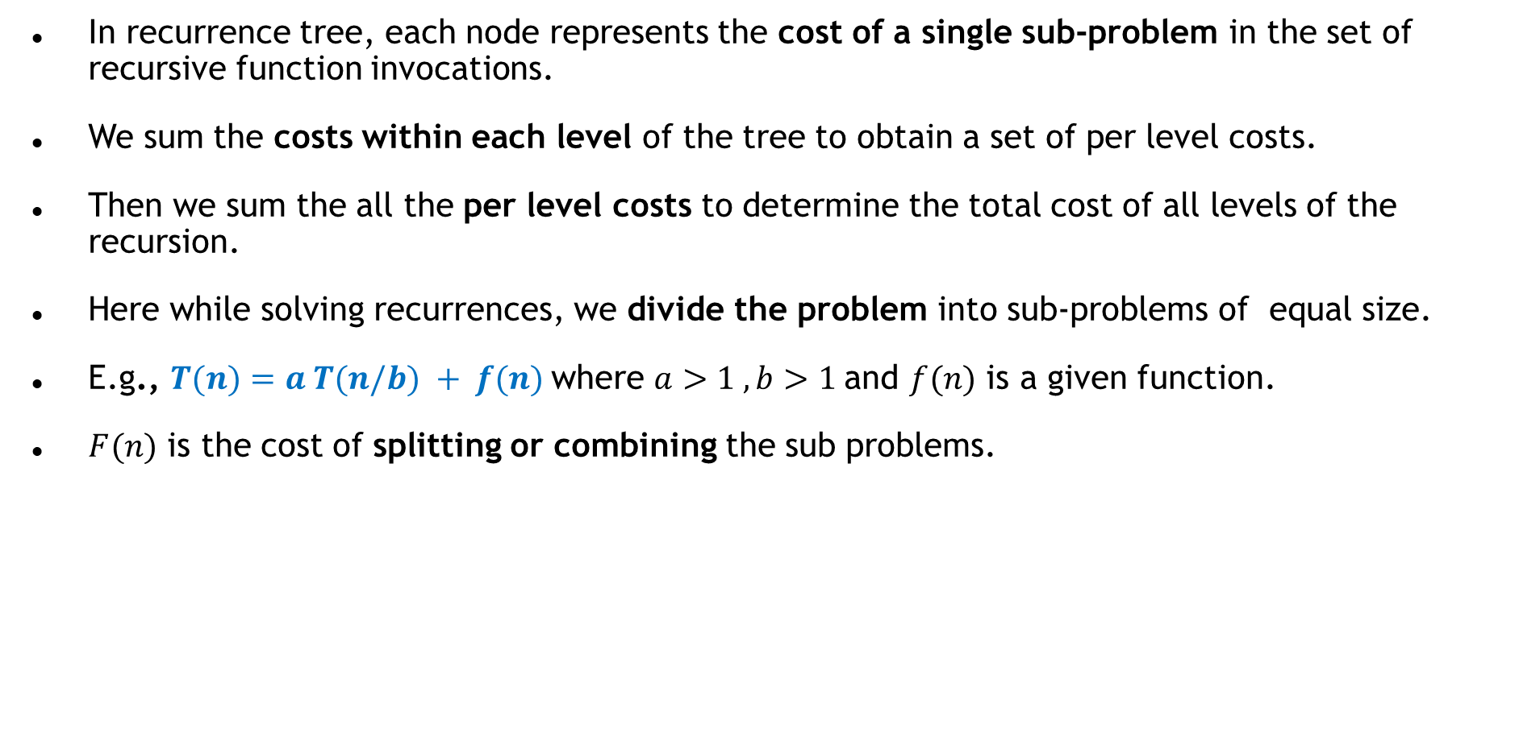
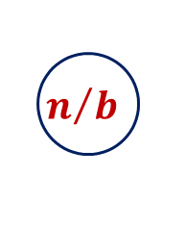
Recurrence tree method
In recurrence tree, each node represents the cost of a single sub-problem in the set of recursive function invocations.
We sum the costs within each level of the tree to obtain a set of per level costs.
Then we sum the all the per level costs to determine the total cost of all levels of the recursion.
Here while solving recurrences, we divide the problem into sub-problems of equal size.
E.g., $T(n)=a T(n/b) + f(n)$where $a>1 ,b>1$and $f(n)$ is a given function.
$F(n)$ is the cost of splitting or combining the sub problems.
$$n$$
$$n/b$$
$$n/b$$

Slide 125
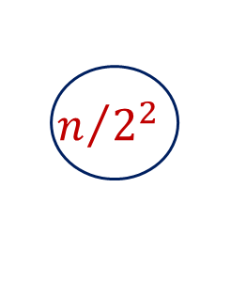


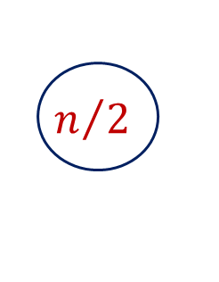

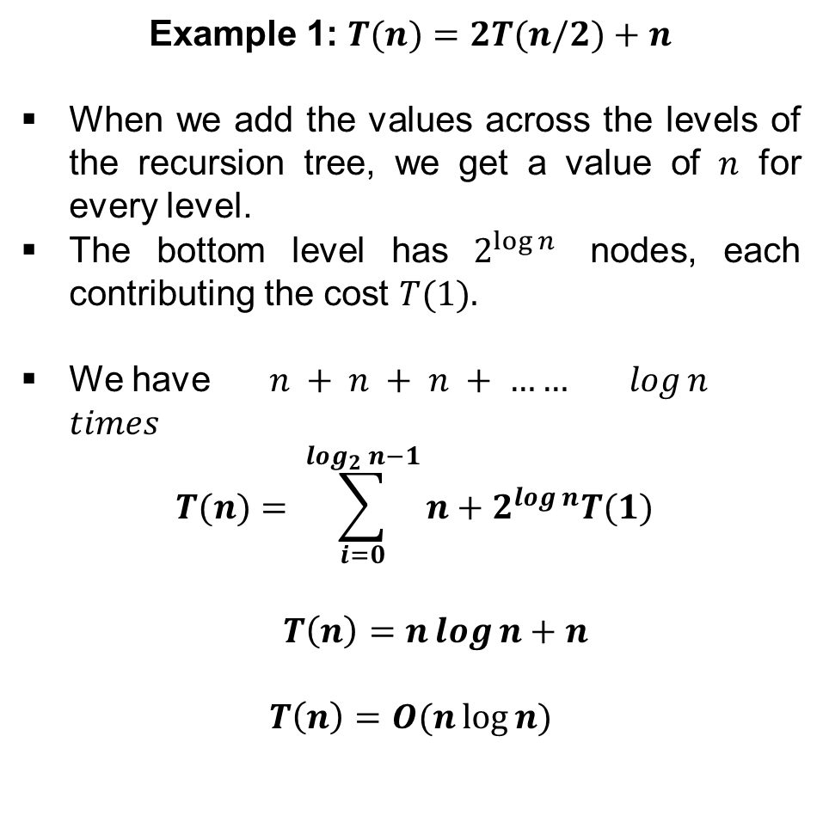
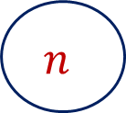


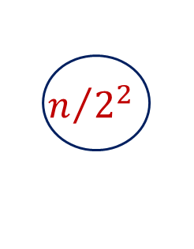



Recurrence tree method
The recursion tree for this recurrence is
Example 1: $T(n)=2T(n/2)+n$
When we add the values across the levels of the recursion tree, we get a value of $n$ for every level.
The bottom level has $2^{\log{n}}$ nodes, each contributing the cost $T(1).$
We have $n + n + n + …… log⁡n$ $times$
$$T(n)= \sum_{i=0}^{\log_{2}{n}−1}{n+2^{\log{n}}T(1)}$$
$T\left(n\right)=n\log{n}+n$
$$T\left(n\right)=O(n\log{n)}$$
$$n$$
$$n/2$$
$$n/2$$
$$n$$
$$log2 n$$
$$n/{2^{2}}$$
$$n/{2^{2}}$$
$$n/{2^{2}}$$
$$n/{2^{2}}$$
$$n$$
$$1$$
$$1$$
$$1$$
$$1$$

Slide 126
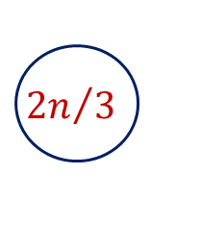
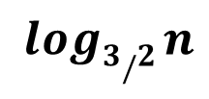

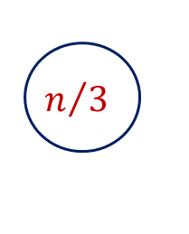
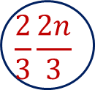
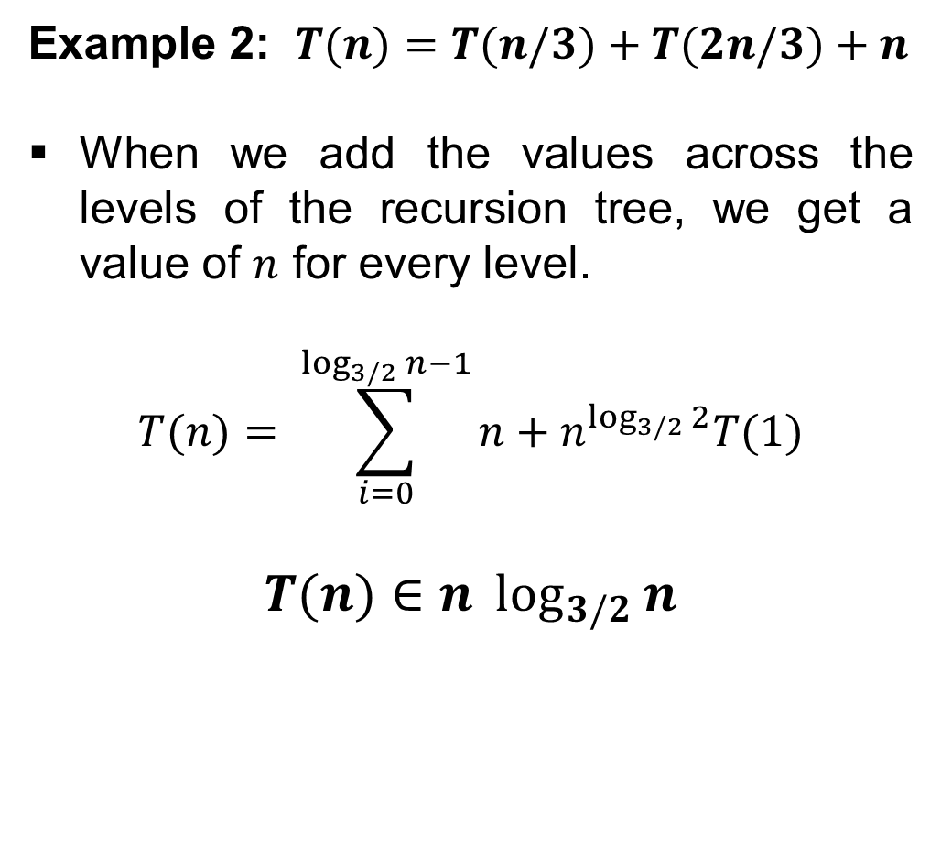
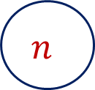
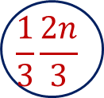

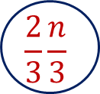

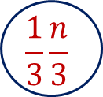
Recurrence tree method
Example 2: $T(n)=T(n/3)+T(2n/3)+n$
When we add the values across the levels of the recursion tree, we get a value of $n$ for every level.
$$T(n)= \sum_{i=0}^{\log_{3/2}{n}−1}{n+n^{\log_{3/2}{2}}T(1)}$$
$$T(n)∈n \log_{3/2}{n}$$
The recursion tree for this recurrence is
$$n$$
$$n/3$$
$${2n}/3$$
$$n$$
$$log3 n$$
$$log3/2 n$$
$$\frac{1}{3}\frac{n}{3}$$
$$\frac{2}{3}\frac{n}{3}$$
$$\frac{1}{3}\frac{2n}{3}$$
$$\frac{2}{3}\frac{2n}{3}$$
$$n$$

Slide 127
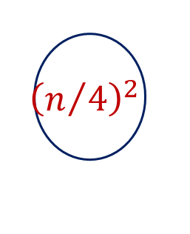
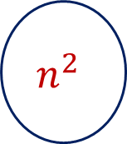
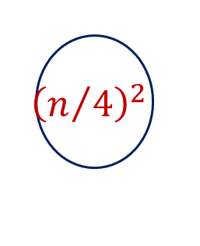

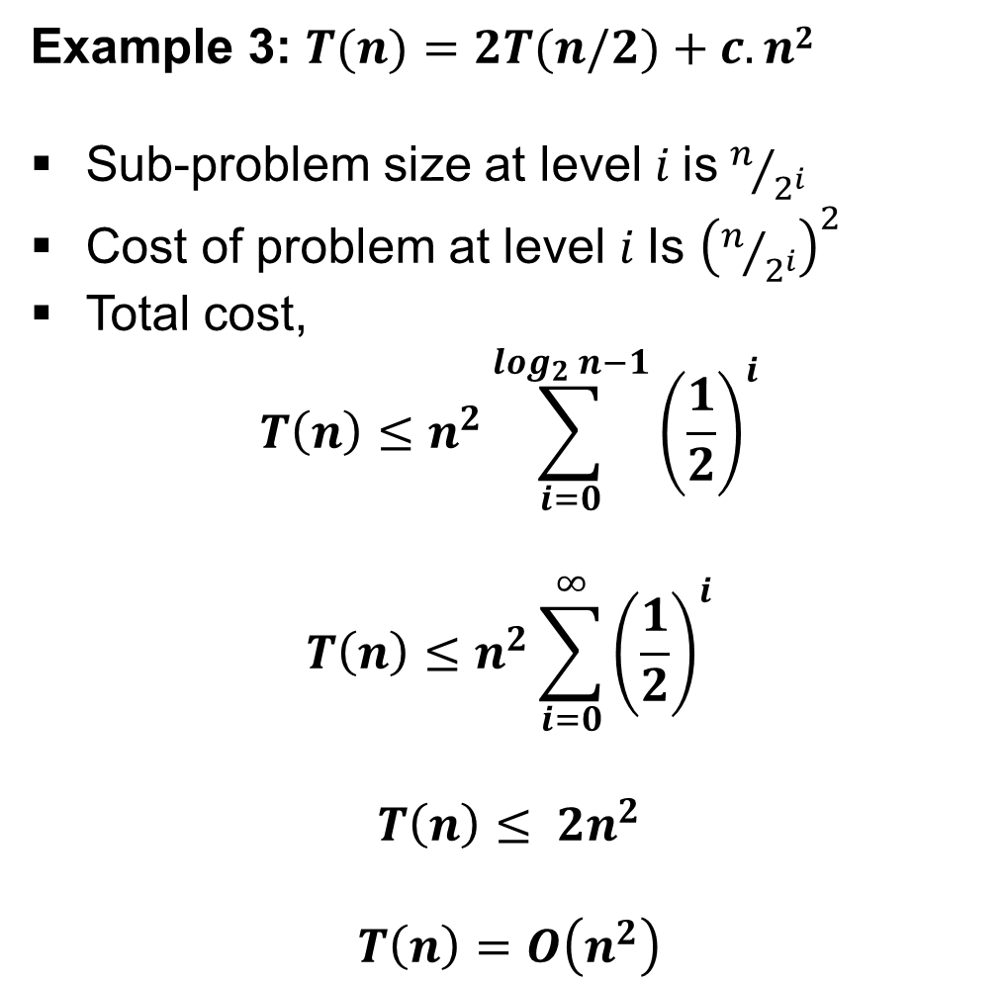
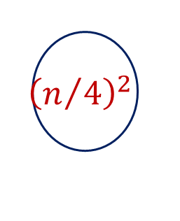

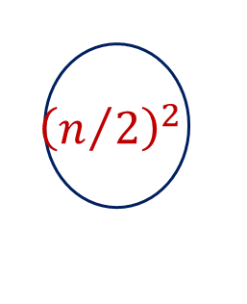

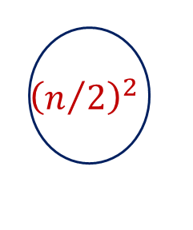

Recurrence Tree Method
The recursion tree for this recurrence is
Example 3: $T(n)=2T(n/2)+c.n2$
Sub-problem size at level$i$is $n/{2^{i}}$
Cost of problem at level $i$Is ${\left(n/{2^{i}}\right)}^{2}$
Total cost,
$$T\left(n\right)≤n^{2}\sum_{i=0}^{\log_{2}{n−1}}{{\left(\frac{1}{2}\right)}^{i}}$$
$$T\left(n\right)≤n^{2}\sum_{i=0}^{∞}{{\left(\frac{1}{2}\right)}^{i}}$$
$$T\left(n\right)≤ {2n}^{2}$$
$$T\left(n\right)=O\left(n^{2}\right)$$
$$n^{2}$$
$${\left(n/2\right)}^{2}$$
$${\left(n/2\right)}^{2}$$
$${1/2n}^{2}$$
$${\left(n/4\right)}^{2}$$
$${\left(n/4\right)}^{2}$$
$${\left(n/4\right)}^{2}$$
$${\left(n/4\right)}^{2}$$
$${1/4n}^{2}$$
$$O\left(n^{2}\right)$$

Slide 128
Thank You!

